Slide 1
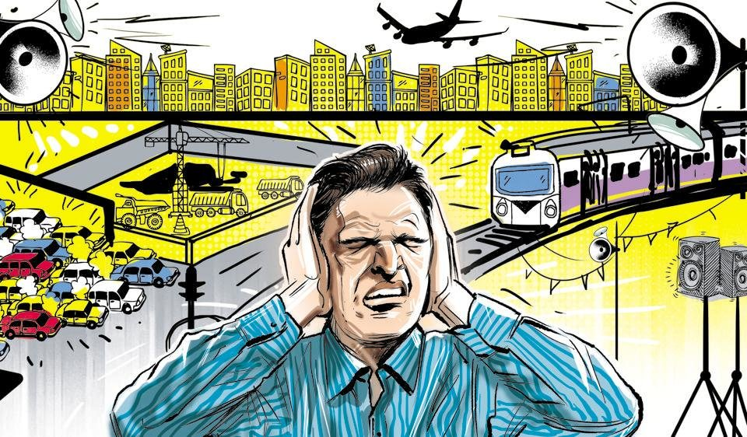
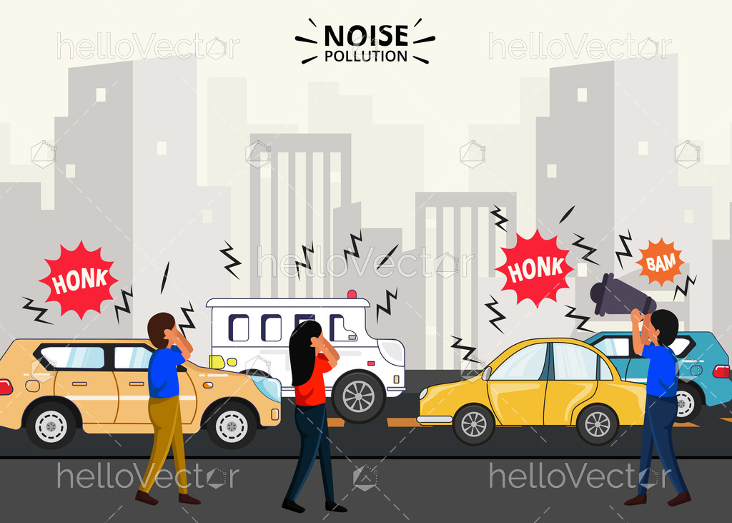
NOISE POLLIUTION
NAME– NAMRATA MAITY
COLLEGE NAME- PANSKURA BANAMALI COLLAGE (AUTONOMUS)
SEMIESTER-
REGISTRATION NO.-
ROLL NO.-
SUBJECT-

Slide 2
ACKNOWLEDGMENT
I would like to express my special thanks of gratitude to the honourable Professor Dipak Samanta to give me the golden opportunity to do wounder project of ENVS on ‘Noise Pollution’ and also helping me in completing my project. I would also like to thank my parents and my friend of my group who help me lot in finalizing within the limited time frame.
Thank You

Slide 3
INDEX
Topic Page no.
1. Introduction 4-6
2. Types of Noise pollution 7-8
3. Source of Noise pollution 8-13
4. Effects of Noise pollution 13-18
5. Prevention of Noise pollution 19-24
6. Noise pollution in rural area of India 25
7. Noise pollution in urban of India 26-27
8. Governmental laws on Noise pollution in India 27-28
9. Green Muffler Scheme 29-30
10. Conclusion 31-32
11. Bibiography 32-33

Slide 4
INTRODUCTION
What is noise?
Sound, a normal feature of our life, is the means of communication and entertainment in most animals, including human beings. It is also a very effective alarm system. A low sound is pleasant whereas a loud sound is unpleasant and is commonly referred to as ‘noise’. tha Noise can be defined as an unpleasant and unwanted sound t is loud and disruptive to hearing. There are 4 different types of noise: continuous, intermittent, impulsive and low frequency. Continuous noise refers to noise that is produced continuously by machinery that does not stop working while intermittent noise refers to the quick rise or drop in the noise volume. Additionally, impulsive noise is characterized by its sudden and fast nature. Low frequency noise refers to the background noise that we hear in our surroundings. These 4 types of noise contribute to the noise pollution that we experience daily, especially in our highly urbanized world today.

Slide 5
What is noise pollution?
Noise pollution, also known as sound environmental noise pollution, is the propagation of noise with or ranging impacts on the activity of human or animal life, most of them harmful to a degree. Florence Nightingale recognized noise as a health hazard in 1859 when she wrote,
“ Unnecessary noise is the most cruel abuse of care which can be inflicted on either the sick or the well.”

Slide 6
Noise pollution, an urban territorial phenomenon is assuming serious proportions in every city. The frequency and intensity of pollution has been increasing day by day. Noise pollution is an annoyance to human beings. The noise is usually machine-created sound that disrupts activity or balance of human’s way of life. It is a growing environmental problem that is increasingly becoming an omnipresent, yet unnoticed form of pollution not only in developed countries but also in the developing countries. The word noise is derived from Latin word ‘‘Nausea’’ implying ‘‘unwanted sound’’ or sound that is loud, unpleasant or unexpected. It can be defined as wrong sound, in the wrong place and at the wrong time. The noise problems of the past pale in significance When compared with those experienced by modern city dwellers; noise pollution continues to grow in extent, frequency, and severity as a result of population growth, urbanization, and technological developments. Due to exposure of noise people are suffering from difference kinds of diseases like hearing impairment, interference with spoken communication, Sleep disturbances, cardiovascular disturbances, annoyance etc.

Slide 7
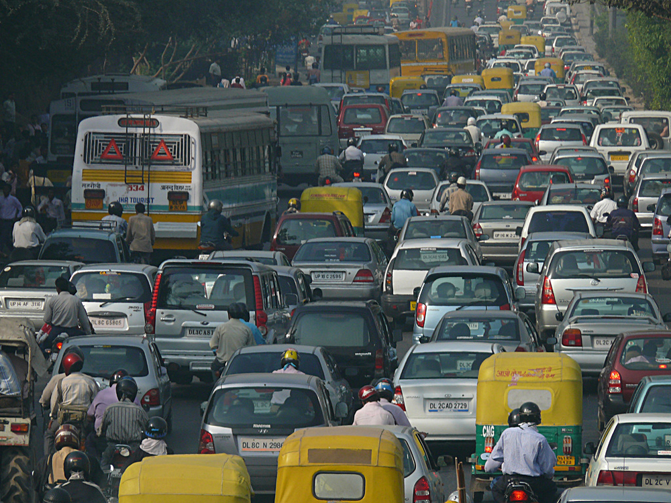
TYPES OF NOISE POLLUTION
The types of noise pollution are category broadly.
1.Industrial Noise
Industrial noise is caused by some high intensity decibels that is the result of industry machines and other such appliances. The noise comes from the use of mills, heavy industrial machines and even the small exhaust fans that run for a long period. Noise from mechanical saws and pneumatic drills is unbearable and the ultimate form of pollution to the public and neighborhood. This is one cause of noise pollution.
2.Transport Noise
Transport noise is s imply inevitable. The traffic jams cause considerable amount
This Photo by Unknown Author is licensed under CC BY

Slide 8
of vehicle noise and the honking of the many vehicles in the crowd are nothing but a pure nuisance. Whether road, rail or aircraft, their noise is a considerable contributor to noise pollution. Tractors and other heavy vehicle sounds are difficult to control for their sound.
3.Neighbourhood Noise
Gadgets, electrical appliances like the grinder and mixer are the prime contributors to noise pollution. Loud loudspeakers in the name of wedding, political parties and other such events call for a significant amount of noise pollution. In the long run, they become difficult to bear posing problems to the health of humans.
Sources of Noise Pollution
Noise contamination is an undesirable or hostile sounds that irrationally interfere into our day by day exercises. It has numerous sources, the majority of which are related with urban improvement like street, air ,rail transport, modern noise , neighborhood and recreational commotion. Various components add to

Slide 9

issues of high noise levels, including expanding population and expanding commotion levels in a vehicle . Major causes / sources of noise pollution are:
1.Industrial Sources
Progress in technology (industrialization) has resulted in creating noise pollution . Textile mills, printing presses, engineering establishments and metal works etc. contribute heavily towards noise pollution. In industrial cities like Kolkata, Ludhiana, Kanpur etc., often the industrial zones are not separated from the

Slide 10
residential zones of the city especially in the case of small scale industries. These operate from workshops located on the ground floors of the residential areas and cause annoyance, discomfort and irritation to the residents exposed to the noise that is inevitably produced. The situation is much better in modern planned cities like Chandigarh where the industrial area is kept away from the residential areas and both are separated from each other by a sufficiently wide green belt.
2.Transport Vehicles
Automobile revolution in urban centers has proved to be a big source of noise pollution. Increasing traffic has given rise to traffic jams in congested areas where the repeated hooting of horns by impatient drivers pierce the ears of all road users.

Slide 11
Noise from airplanes constitutes an increasing serious problem in big cities like Delhi & Mumbai. Airport situated in the vicinity of population centers and the air planes pass over residential areas. Heavy trucks, buses trains, jet mopeds, jeeps planes, motor —cycles, cotters, the list of vehicles is endless but the outcome is same —
3. Household noise pollution
The household is an industry in itself and is a source of many indoor noises such as the banging of doors, noise of playing children, crying of infants, moving of furniture, loud conversation of the inhabitants etc. Besides these are the entertainment equipment in the house, namely the radio, record players and television sets. Domestic gadgets like the mixer pressure cookers, desert coolers, air grinders, conditioners, exhaust fans, vacuum cleaners, sewing and washing machines are all indoor sources of noise pollution
4.Public Address System
In India people need only the slightest of an excuse for using loud speakers. The reason may be a religious function, birth, death, marriage, elections demonstration, or just commercial advertising. Public system, therefore, contributes in its own way towards noise pollution.

Slide 12

5.Agricultural Machines
Tractors, thrashers, harvesters, tube wells, powered tillers etc. have all made agriculture highly mechanical but at the same time highly noisy. Noise level 90 dB to 98 dB due to running of farm machines have been recorded in the state of Punjab.
6. Defence Equipment
A lot of noise pollution is added to the atmosphere by artillery, tanks, launching of rockets, explosions, exercising of military airplanes and shooting practices. Screams of jet engines and sonic booms have a
This Photo by Unknown Author is licensed under CC BY-NC-ND

Slide 13
deafening impact on the ears and in extreme cases have been known to shatter the window panes and old dilapidated buildings.
7. Miscellaneous Sources
The automobile repair shops, construction works, blasting, bulldozing, stone crushing etc. are other sources of noise pollution. The effects of noise pollution has a ill effects not only on the human beings but also on other living and non living things, which will be discussed below:
Effects of Noise Pollution
Repeated Interference with sleep:
In a social survey carried out amongst people living in the vicinity of London Airport, some 22 per cent said that they sometimes found difficulty in getting to sleep because of airport noises. In areas where the noise level was particularly high, up to 50 per cent complained about the noise. An even higher per centage said they were awakened by high intensity noises, usually early at night when sleep was not yet deep. After people have been asleep for some hours, they do not readily wake up, even when subjected to very loud noises. Different

Slide 14
people have different depths of sleep and they can adjust to nocturnal sounds. Undoubtedly, however, noisy conditions near residential areas at night must be avoided lack of continuous sleep has as counteract it. Many techniques for sound insulation are available today and ca n be applied at relatively modest expense.
2. Effect on hearing or deafness:
These effects only become of real importance if the sounds are exceptionally loud. Continuous exposure to noise levels much above 100 dB has an adverse effect on hearing ability within a fairly short time. Many workers who are exposed to the noise of jet aircraft or very noisy workshops for even moderate periods soon develop detectable hearing defects. Today it has become the practice for workers in these situations to the

Slide 15
equipped with ear protectors and provided these are worn all the time hearing ability is not affected.
3. Effect on Communication or Speech Interference:
External sounds can interfere with conversation and use of the telephone, and well as the enjoyment of radio and television programmes and like pastimes. It can thus affect the efficiency of offices, schools and other places where communication is of vital importance. The maximum accepted level of noise under such conditions in 55 dB. 70 dB is considered very noisy and serious interference with verbal communications is inevitable.

Slide 16
4.Mental or Physiological Effects:
Many people complain that noise makes them mentally ill. Experiments have been performed to attempt to confirm or disprove these claims. According to the H.M. Stationary Office report Noise; noise certainly does not contribute in the least to mental illness. Doctors and scientist have now medically confirmed that noise disturbs the biological organisms and their respective functions of the humans. Fire crackers and other excessive and continuous explosives become physically painful giving rise to neurosis, mental illness, cardiovascular diseases, stomach ulcers and respiratory disorders reducing human life. Recent researches have concluded that sho rt exposures to noise (in excess of about 100 dB) leads to adverse effects on foetus, headache and, dizziness, dilatoriness in intestines, stomach problems and effects on eye sights to the extent that these at times become incurable.
5. Effects on Physical Health and working efficiency or Psychological problems:
Noise has little physical effect on the biological performance provided that the noise level is below about 90 dB. Damage to the inner ear may result if continuous noise levels exceed about 100 dB as has been observed by the Doctors leading to physical illness. Psychiatrists and psychologists have in recent researches have made observations that noise

Slide 17
has certain relation with physical health causing tension resulting in problems such as speech interference, annoyance, fatigue, sleep interference and emotional distress. Noise levels in industries causes interference in efficiency and communication and raises possibilities of accidents. World Health Organization has estimated remarkable loss in the industries annually.
6. Effects on other animals and other living things:
The effect caused by industries, railways, crackers, explosions and commotion in the cities, aircrafts etc.,

Slide 18
can be felt on animals, birds, mice, fishes and domestic animals for they are susceptible to various effects of due to exposure noise levels change their places. Birds avoid migrating to places where noise level is above 100 dB. The noise emissions caused by supersonic aircraft, railway noise emissions etc. , may cause miscarriage in mammals and fishes as well as birds are observed to have stopped laying eggs. Thus to sum up animals and other living things become upset more than human beings and in the direct cause of ecological in balance.
7.Effect on nonliving things:
Intense noise levels affects non living things too. The noise booms cause cracks in national and archaeological well as very high . monuments as levels of noise are the cause of cracks in hills. High intensity explosions can break glass panes and vibrations in the buildings. Research work at India and abroad is being done so as to access its gravity on nonliving things so that precautions could be taken forehand to reduce impact therefore.

Slide 19
Prevention of Noise Pollution
We can reduce noise Pollution by following mentioned Tips:
1. Turn of Appliances at Homes and Offices:
We can turn off home and office appliances when not in use such as TV, games, computers etc. it can create unnecessary stress on ears. We can save electricity also when we turn them off.
2. Shut the door when using noisy machines:
We can shut the door after we turn on dishwashers or washing machines for rooms where it is kept or we can turn them on before leaving the house so that overlapping of exposure to loud noises can be reduced

Slide 20
3.Use Earplugs:
Use of earplugs or earmuffs can bring down loud noises to a manageable level. Earplugs are small inserts that fit into our ear canal. And earmuffs fit over the entire outer ear to form an air seal keeping ear s safe from loud noises.
4. Lower the volume:
We can listen to songs, radios, TVs in lower volume when listening from headphones or speakers. Stay away from Noisy area : Noise producing industries, airports, vehicles should be far from residential areas as it is very dangerous for infants and senior citizens.

Slide 21
5.Follow the limits of noise level :
Community law should check the use of loudspeakers, outdoor parties as well as political public announcements.
6.Control of Noise level near sensitive areas:
There should be control on noise level (Silent zones) near schools, hospitals. Place noise limits boards near sensitive areas.

Slide 22
7. Go green by planting trees :
We can plant more trees as they are good noise absorbents. According to studies, it can reduce noise by 5 to 10 decibels Db around them.
8. Create healthy noise to eliminate unwanted noise:
If we can’t eliminate unwanted noise coming from outside then we can create healthier noise such as music, singing birds or waterfalls in homes or offices.
9. Use Noise Absorbents in Noisy Machineries:
We can check for pieces of machinery which are creating noise due to vibrations and put some noise absorbents to reduce noise.

Slide 23
10.Use Proper Lubrication and Better Management:
We can use proper lubrication as well as better maintenance of machines to reduce noise pollution and improve efficiency. It reduces friction between movable parts and helps to reduce noise.
11. Notify authorities about disobedie noise rules:
necessary of We can notify government agencies if someone is not following rules and regulation regarding noise levels.
12. Regularly check noise levels :
Regularly checking noise level in an industrial complex and indoor to keep noise level within the limit. It is

Slide 24
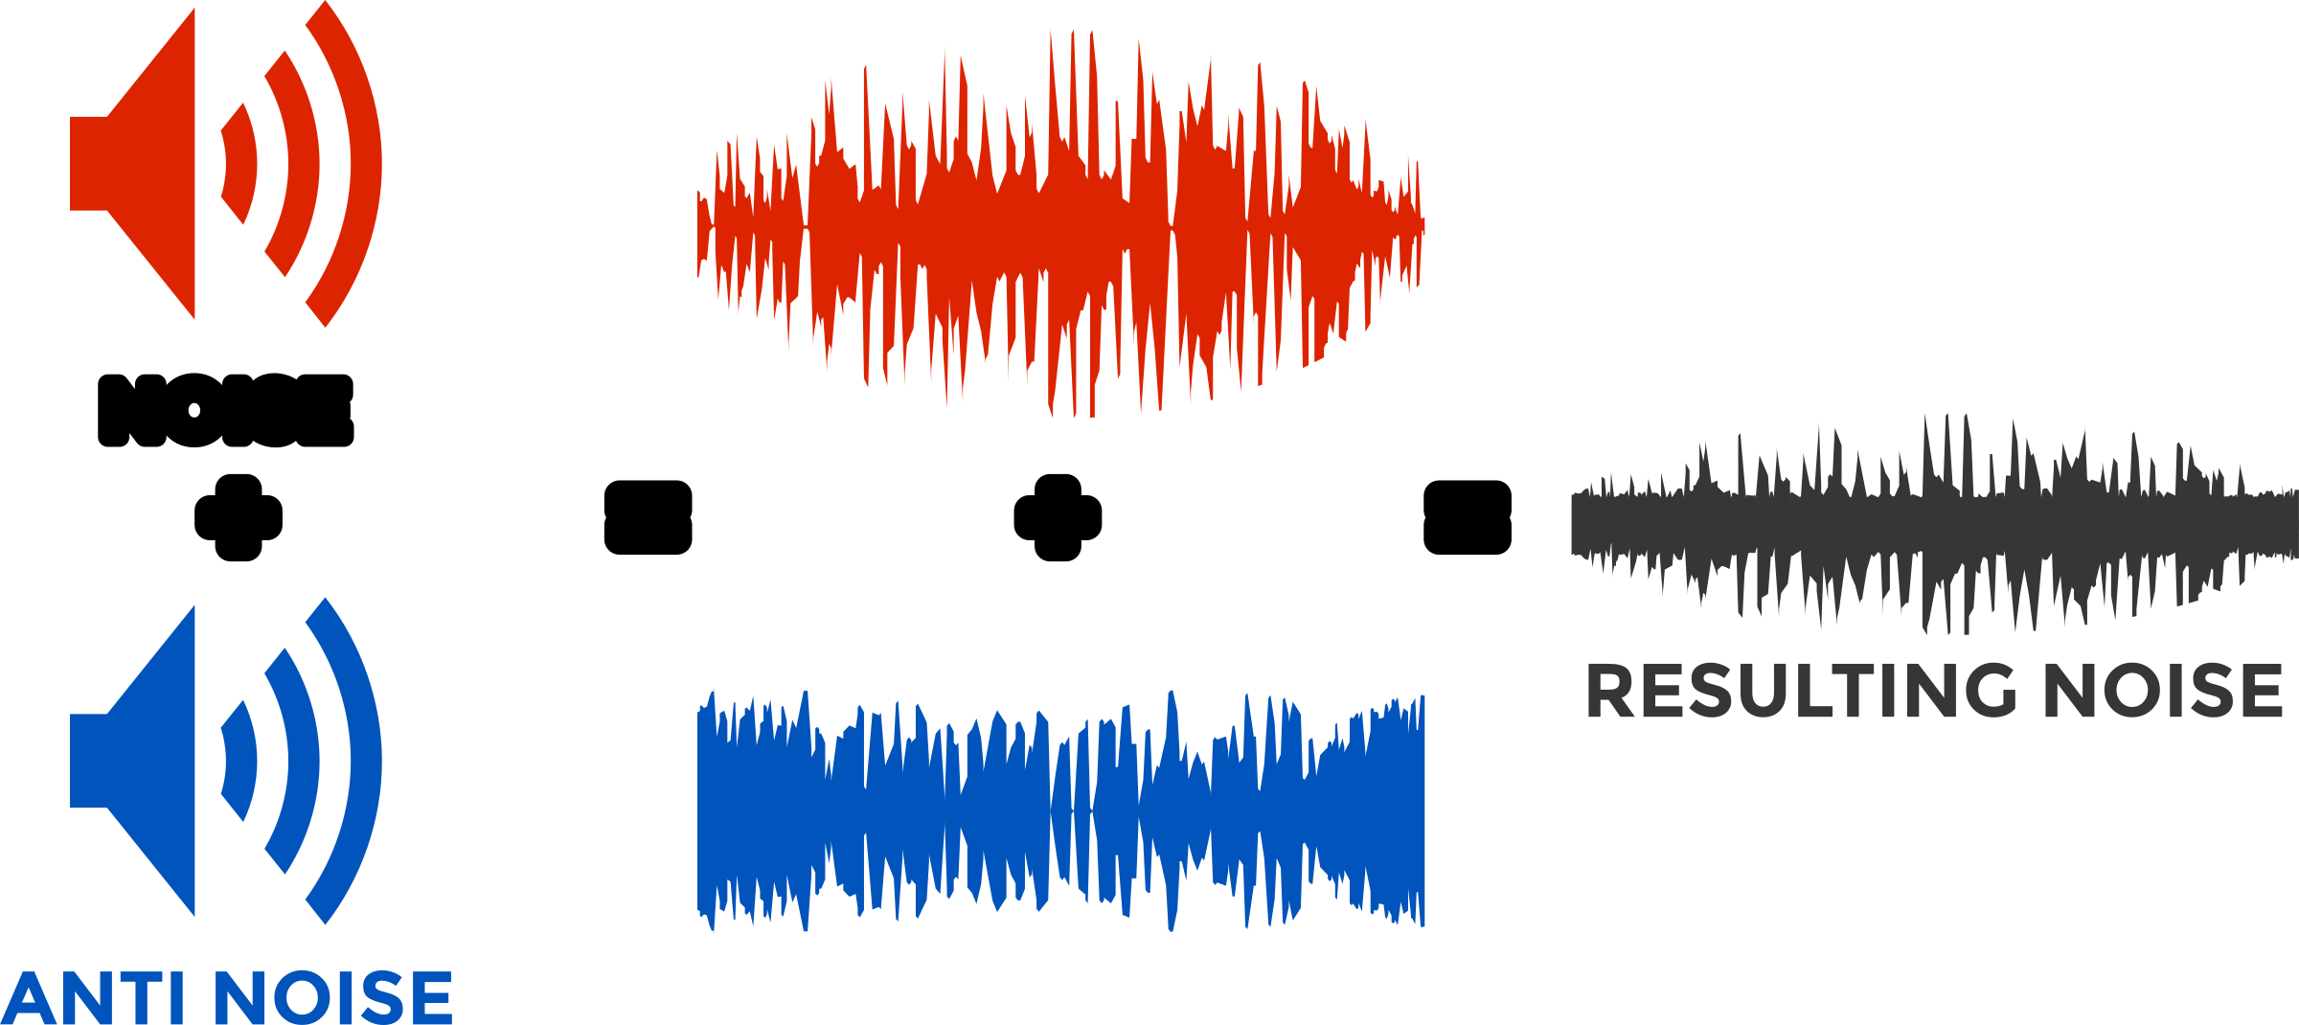
necessary to control the noises created around us. It is necessary to aware people around us through various mediums. We can start from ourselves to spread awareness about noise pollution and its effects on human and the environment. Limit for noise at daytime is 55 dB and in the night it is 30 dB to avoid health effects .

Slide 25

NOISE POLLIUTION IN RURAL AREA
Probable sources of noise pollution in and around rural areas include brick factories, mining and laterite stone cutting, sand mining, poultry, and movement of vehicles. Occasionally festive and private celebrations also contribute to the noise levels.

Slide 26
NOISE POLLUTION IN URBAN INDIA
The urban areas of India have become highly populated in past few decades. In the last decade, it rose by 31.8%. This has led to certain environmental and health issues that also include environmental pollution. Some causes are unavoidable and are required to be followed for the developmental activities. So, it is not possible to completely avoid them. But, some preventive measures sure can be taken to control and minimize the extent of it. As per the Prevention an d Control of Pollution Act implemented in 1981, the noise is termed as an ‘air pollutant’. It is that unpleasant, distracting and unnecessary sound that ought to be avoided due to its sleep depriving and concentration-lowering impact.

Slide 27
The person gets annoy ed due to the persistent uneasiness caused by them. According to the WHO guidelines, for a sound sleep, the noise in that room should not be more than 30dBA. For maintaining concentration in any classroom, it should not exceed 35dBA. The noise levels more than these limits on a continuous basis, may harm mental as well as physical health on a short term and long term basis. Sadly enough, this issue is not taken that seriously in front of other forms of pollution pollution. air pollution and water pollution.
Governmental Actions on Noise Pollution in India
In March 2011, the Central Pollution Control Board established the first part of noise pollution monitoring network in 35 major cities in India including all the metros like Delhi, Kolkata, Mumbai, Hyderabad, Bengaluru, Lucknow and Chennai. The system is a part of the National Environmental Policy adopted in 2006. It is expected that by the establishment of second and third parts, the number of locations to be monitored

Slide 28
will be increased160 cities covering various part of Indian states.
Under the Environmental Protection Act, the Central Government came up with Noise Pollution (Regulation and Control) Rules 2000 which were to be implemented once they got published in the official gazette. These rules are meant for the following:
Implementation of noise standards in different zones or areas. Restrict the use of loud over-- speakers. Restrict the usage of horns, sound creating equipment's for construction and foretaste Pollution crackers. Allotting responsibility ion Control Boards or Committees and the Central Pollution Control Board, for collecting, processing and providing the statistical data about the noise pollution, so that adequate measures may be taken to prevent and control it. On violation of these rules , the person shall be liable for penalty as per the Act.

Slide 29
GREEN MUFFLER SCHEME
Group of Ashoka Trees with new leaves Green Muffler is a technique of reducing noise pollution by planting 46 rows around the populated areas or noisy places like along roadsides, industrial areas, societies near highways, etc. so that dense trees reduce noise pollution as they filter out the noise and obstruct it reaching the citizens. Under this scheme Ashoka and Neem plants are planted near the house or resident localities to reduce noise pollution.

Slide 30
They control noise pollution. Even urban noises are muffled by trees just like stone walls .An advantage of using plants as noise blockers is that they absorb sounds best in the high frequencies that people find it annoying .Ever green shrubs that too with broader leaves provide year round noise protection so, they are best to plant. Trees absorb sound waves with their branches and foliage. Plant trees with no space or less space to reduce noise pollution. In fact soft ground is an efficient noise absorber. So, avoid hard surfaces to plant trees. Also, cultivate the ground before planting and adding organic matter to the surface of the soil may also help to reduce noise when vegetations will be established.

Slide 31
CONCLUSION
• Improved traffic management practices one way traffic movement buses such as , proper management of in the traffic stream may reduce level to some extent. Proper nosebags traffic nonseries should be constructed under flyovers to mitigate the traffic noise level.
• • The Factories Act,1948 does not contain a specific provision of noise control while it has been found in a number of cases that high intensities, high frequencies, high intermittency of noise are the factor of annoyance for the workers. The Central and the State Boards now exercise the powers and functions under Section 16 and 17 the Air Act, respectively with regard to the

Slide 32
prevention and control of noise pollution including the laying down of noise standards.
• Noise adversely affects general health and well being in the same way as does chronic stress. It adversely affects future generations by degrading residential, social, and learning environments with corresponding economic losses.
BIBLIOGRAPHY
I have used the following websites to do the project work:-
• https://en.m.wikipedia.org/wiki/Noise_pollution
• https://www.shutterstock.com/search/noise+pollution
• https://www.nationalgeographic.org/encyclopedia /noise-pollution/
•
https://m.jagranjosh.com/generalknowledge/amp/what-is-green-muffler-and-howit-controls-noise-pollution-1489485937-1
• https://www.medicalnewstoday.com/articles/nois e-pollution-health-effects
https://www.iberdrola.com/environment/whatisnoisepollutioncauseseffects
•solutions https://www.iberdrola.com/environment/whatisnoisepollutioncauseseffectssolutions

Slide 33
• https://www.iberdrola.com/environment/whatisnoisepollutioncauseseffects
•solutions
https://www.iberdrola.com/environment/whatisnoisepollutioncauseseffectssolutions

